Slide 1
What is a Patrol Base?
A patrol base is a security perimeter set up when a fire team, squad or platoon conducting a patrol halts for an extended period
It should not be occupied for more than 24 hours
Never use the same patrol base twice

Slide 2
Uses
To avoid detection by eliminating movement
To hide a unit during a long reconnaissance
To perform maintenance on weapons, equipment, and to eat/rest
To plan and issue orders
To reorganize after infiltrating an enemy area
To establish a base from which to execute operations

Slide 3
Site Selection
Leader of the patrol selects a tentative site via map or aerial recon. Suitability must be confirmed before unit occupies
Plans must include an alternate site; will be used if first site is unusable or if patrol must unexpectedly evac the first patrol base.

Slide 4
Planning Considerations
A patrol base must be located so that the unit can accomplish its mission
Needs:
  Observation Posts w. Comms plan
  Platoon/Squad/Fire Team Plan
  Alert Plan
  Withdrawal Plan to include: Withdrawal routes, rally point, alternate patrol base
  Security system to ensure specific team members are awake at all times
  Enforcement of noise/light discipline
  The conduction of required activities with min. movement and noise
  Priorities of work

Slide 5
Security Measures for PB Site
Terrain with little tactical value
Off main/natural lines of drift
Select terrain that would impede foot movement; dense vegetation, preferably bushes and trees that spread close to the ground
Near a source of water
Terrain that can be defended for a short period and offers good cover and concealment

Slide 6
Security Measures for PB Site
Avoid known or suspected enemy positions
Avoid built up areas
Avoid hilltops and ridges, except as needed for maintaining comms
Avoid small valleys
Avoid Roads and Trails

Slide 7
Recon
Team establishes a security halt (100-200m at night, 200-400m day)
Patrol Leader preps leader’s recon team to include:
  Himself
  Fire Team
Patrol Leader issues GOTWA to Team Leaders, TL to their fire teams

Slide 8
Clearance
LDR Recon moves to tentative PB site in a squad column, fireteam wedge
Upon reaching LPOP (Listening post/observation post) position, recon patrol turns 90 degrees and continues to PB site
Once Recon patrol reaches the PB site, PL leaves one AB at tent. 6’ o'clock position
Security squad spreads out on-line, with one AB on the far left and one on the far right (Approx 50m across)
Line clears 50-75m, walking away from the 6 o'clock (HQ element walks behind them)
Looking for signs of enemy activity and security criteria previously mentioned

Slide 9
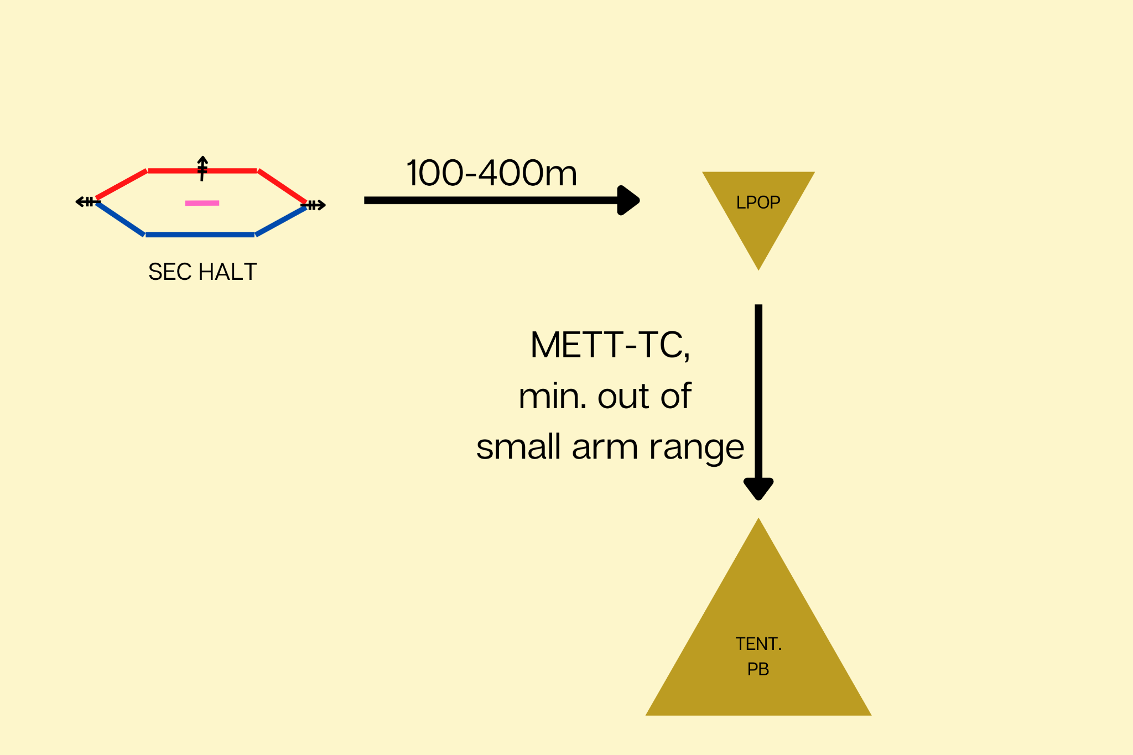

Slide 10
Occupation
Assuming there are no security threats, PL confirms PB location and leaves the ABs, security squad, and WSL at PB site
Returns to LPOP and leaves SAW gunner and Rifleman
  Gives them engagement criteria, compromise plan, and GOTWA
Returns to rest of platoon and guides them to PB

Slide 11
Occupation
Once squads are emplaced, PL and one SL inspect the perimeter and make adjustments as necessary
After inspection, each sector sends a two man Recon/Surveillance team to center of PB
PL briefs R&S teams on recon method and criteria (water, sign of enemy, roads, trails, possible rally points)
PL directs when the teams leave; typically only one leaves the perimeter at a time
Three methods: Post, T, Apex

Slide 12
Occupation
Platoon remains at 100% alert during R&S (Everyone on a knee, rucks on)
Upon completion of R&S, PL confirms or denies the patrol base location
If denied, the platoon makes plans to move to alternate patrol base site
If confirmed, Patrol Base is considered ‘occupied’.
PL makes any perimeter adjustments based off R&S patrols
Platoon starts defensive plan

Slide 13
Establishment/Priorities of Work
Not a laundry list of tasks that need to be accomplished
Centralized at the platoon level
Minimum 33% security at all times and with ALL belt feds manned (when not being cleaned)
Radios monitored at all times
POW conducted off the line
LPOP does not conduct POW
Clear task, conditions, and standards given

Slide 14
Priorities of Work
Including but not limited to:
Security (Continuous)
Withdrawal Plan
Communication (Continuous)
Mission Prep/Planning
Weapon and Equipment Maintenance
Water Resupply
Mess Plan
  Which includes rest plan, alert plan/stand to, resupply, sanitation and hygiene

Slide 15
Security
Once PB is established, the security/defense plan is built prior to anything else
Each leg’s designated squad leader builds a sector sketch with interlocking fields of fire for every fighting position
  Needs to have even distribution of firepower
  Claymore position needs to be marked on sketch, and set up to cover any defilades or the front of the leg as a whole.
  Claymore clacker usually kept at a M249 position as they will always be manned
The far edges of the sector sketch need to interlock with the other legs of the PB; gun positions are not included with sector sketch

Slide 16
Security
Gun positions build range cards
Once each squad and gun team builds their sketch, they return their sketch to the PL who spot checks and makes any necessary adjustments.
Withdrawal plan is created and disseminated, consisting of a black and gold plan, alternate PB location, signal for withdrawal, and order of withdrawal

Slide 17
Example Sector Sketch
Typically built to be reusable; isosceles triangles for each line that come together to make equilateral triangle in shape of patrol base
Built from lum tape, MRE cardboard boxes, and waterproofed with lamination paper or packing tape.

Slide 18
Black and Gold Plan
Consists of two different rendezvous points in opposite compass directions from each other
Used if PB is overrun or if platoon needs to make a hasty withdrawal
Generally at least one major terrain feature away from PB
All Rangers must know distance, direction, and description of RV points
Generally an easily identifiable terrain feature
Example:
Gold: 265°, 400m, hilltop
Black: 45°, 500m, intersection of stream and road

Slide 19
Security
Challenge and Password, running password, and number combos created
Challenge/password are two different words used to verify someone is a member of the patrol/platoon if outside the perimeter of the patrol base
Someone on security will ‘challenge’ someone with a word and a specific word must be said to complete the challenge (the password)
Example: Thunder (challenge) Flash (Password)

Slide 20
Security
Number combo: Used for visual confirmation at distance or lowlight
Number needs to be odd; (3,5,7,9 all work well)
Example: Number combo is 7. Ranger on security sees movement in the dark in front of his position, flashes his IR light 3 times and receives 4 flashes in return, confirming element is friendly

Slide 21
Security
Running Password: a word repeated a set number of times for if an element needs to make a hasty return to PB.
Element leader will be yelling running password to let defensive perimeter know they’re friendly
Typically only used after contact has been initiated in some fashion
Example “RANGER RANGER RANGER”

Slide 22
Security
Stand-to procedure: 100% security at BMNT and EENT, PL needs to disseminate exact time
Alert Plan: How Rangers on the line will alert leadership to possible threats discreetly
Noise/light discipline strictly enforced
One apex of the PB is designated as the entrance/exit and is the only place Rangers are allowed to leave and enter from; PSG counts Rangers out
Once security plan/sector sketches are complete and disseminated, PL spot checks and then the PB is considered established

Slide 23
Security
Hasty fighting positions are dug; all belt-feds stay manned
18 inches deep at the front and sloping gently from front to rear with a grenade sump if possible
Dig in buddy-team pairs; one digs while the other pulls security
240 positions dig to name-tape level in Florida phase

Slide 24
Weapons Maintenance
Once security is established and positions are dug, Platoon conducts wpns maintenance
Not detailed at night, at most removing bolt and wiping down internal to the receiver and the bolt assembly or carrier group as to not lose small pieces
Only one 240 is ever off the line at one time; when off the line, they are replaced by a 249 and their covered leg of the patrol base is on 100% security

Slide 25
Wpn Maintenance Example Schedule
Squad | 10 Min | 10 Min | 10 Min
1st | 100% (240 off-line) | 249, 203, 50% M4 | 249, 203, 50% M4
2nd | 249, 203, 50% M4 | 100% (240 off-line) | 249, 203, 50% M4
3rd | 249, 203, 50% M4 | 249, 203, 50% M4 | 100% (240 off-line)
HQ | PSG, MED | PL, RTO | WSL, FO

Slide 26
Personal Hygiene
Minimum change of socks and any wet clothing at night, during day, minimum of shaving and brushing teeth
Medic digs slit trench and designates urination spots
Security doesn’t drop below 50%; conducted in buddy team pairs
PL designates TCS

Slide 27
Mess Plan
No less than 50% security
Open and eat one package at a time, consume the entire meal
All trash returns to rucksack
Water resupply conducted if needed (usually in the morning)
  Usually at least one rifleman from each squad, carrying either an empty ruck or duffel bag with everyone’s empty canteens/camelbacks with PSG

Slide 28
Rest Plan
Everyone’s favorite
No less than 33% security, belt feds and claymores must be manned at all times
LPOP’s at 100% at all times
  PSG ensures LPOPs conduct POW prior to change over

Slide 29
Priorities of Work, Daytime
Stand-to at BMNT
Re-send R&S teams
Re-establish LPOP on key terrain and avenues of approach
Re-adjust and expand perimeter as needed
More detailed priorities of work are conducted

Slide 30
POW, Daytime
MGs are disassembled on ponchos for thorough cleaning
Leadership change-over/layouts (RGR school only)
Begin planning for follow-on operations
Disseminate the plan, conduct rehearsals and inspections
Distribute ammo and water
BL: repeat security plan and POW in a more detailed manner

Slide 31
Tips
Don’t use open red lens; get under 2 ponchos min
Make patrol base look as neat as possible in the AM; straight lines, neat ruck plan, to-standard fighting positions
MAKE SURE POW ARE CENTRALIZED

Slide 32
Planned Withdrawal
LPOP teams recovered
Secure all equipment
Fill slit trench and fighting positions
Make sure all trash is picked up
Platoon leaves through the 6 o’clock in the order of movement towards either next patrol base site or towards the day’s objective

Slide 33
SOP’s to build prior to patrolling
Compromise Plan for:
Security Halt
LDR Recon
Occupation
LPOP
SOPs:
Occupation
Guns to Squads
H20 Resupply
Cache Recovery
LDR Recon
Ruck Plan
Alert Plan
Withdrawal Plan

